Slide 1

Customer Behaviour Analysis

Slide 2
Business Scenario
I am working as a Data Analyst for a leading retail company that sells products across multiple channels (online and offline).
Recently, the company has observed:
Changing customer purchasing behavior
Variation in sales across product categories
Differences in performance between online and offline channels
Management wants data-driven insights to better understand customer behavior and improve business performance.
Key Pain Points
Lack of clear understanding of customer preferences → Ineffective decision-making
Unclear impact of discounts and promotions → Reduced profitability
Low customer engagement and retention → Weak long-term loyalty
Inconsistent performance across channels → Missed revenue opportunities
Limited visibility into repeat purchase behavior → Poor customer lifetime value
Seasonal trends not fully utilized → Lost sales potential
Generic marketing strategies → Low conversion rates
Difficulty identifying high-value customers → Inefficient targeting

Slide 3
KPI SUMMARY :
KPI | Value | Analysis | Insight
Total Revenue | $233K | Strong revenue generated across categories, with Clothing dominating | Revenue is concentrated in few categories → risk & opportunity
Average Rating | 3.75 | Ratings are moderately high but not excellent | Customer satisfaction is decent but has room for improvement
Total Customers | 3.9K | Large customer base with diverse demographics | Good scale for segmentation and targeting
One-time Customers | 83 | Very small portion of customers purchase once | Opportunity to convert remaining into repeat buyers
Average Order Value | $59.76 | Stable spending pattern across customers | Pricing strategy is consistent but not optimized

Slide 4
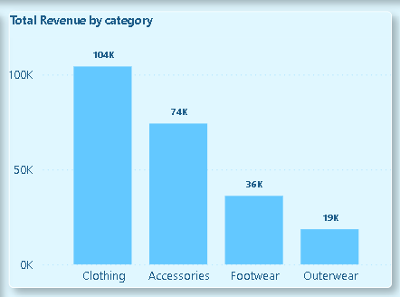
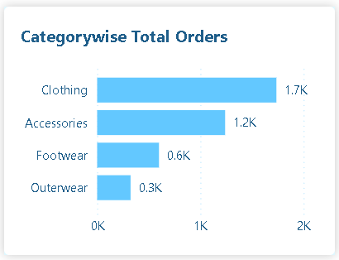
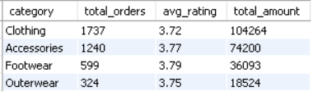
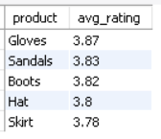
📦 PRODUCT & CATEGORY INSIGHTS :
KPI | Value | Analysis | Insight
Top Revenue Category | Clothing ($104K) | Dominates both revenue and orders | Core business driver → prioritize inventory & marketing
Lowest Engagement Category | Outerwear (324 orders) | Lowest orders despite decent ratings | Demand issue, not quality issue
Highest Rated Products | Gloves (3.87), Sandals (3.83) | High satisfaction but not necessarily top-selling | Opportunity to promote high-rated products more
Top Purchased Products | Blouse, Pants, Jewelry | High demand items across categories | Focus on availability & upselling
Low Rated Products | Shirt, Jeans, Blouse (≈3.6–3.7) | Slightly lower ratings in high-volume products | Quality improvement needed in core items

Slide 5
📦 Recommendation :
Recommendation | Action to Take | Rationale
Boost Outerwear Sales | Launch seasonal campaigns, bundles, and improve homepage visibility for Outerwear | Low sales despite good ratings → demand/visibility issue
Strengthen Clothing Category | Maintain high inventory and run upsell/cross-sell campaigns | Clothing is the highest revenue driver → maximize ROI
Focus on Top Products | Ensure availability of Blouse, Pants, Jewelry | High demand products should never go out of stock
Promote High-Rated Products | Highlight Gloves, Sandals, Boots in ads and recommendations | High satisfaction → easy conversion to sales
Improve Low-Rated High-Volume Products | Fix issues in Shirt, Jeans (quality, fit, material) | Small improvements here impact large customer base

Slide 6
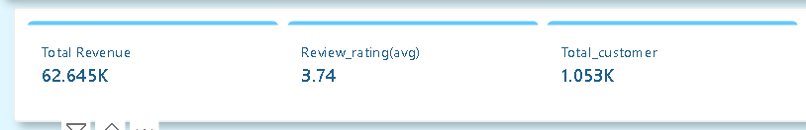
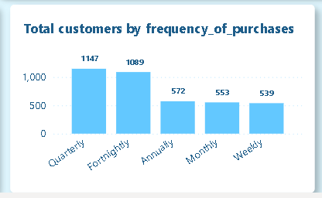
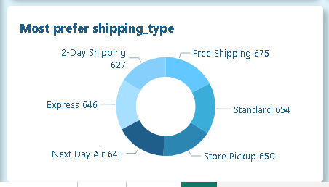
CUSTOMER BEHAVIOR INSIGHTS :
KPI | Value | Analysis | Insight
Subscription Impact | Non-subscribers = 170K revenue vs Subscribers = 62K | Subscribers are fewer but consistent | Subscription model underutilized
Repeat vs Subscription | Only 958 repeat buyers are subscribed | Majority of repeat buyers are NOT subscribed | Huge opportunity for subscription conversion
Purchase Frequency | Quarterly & Fortnightly dominate | Customers purchase in cycles | Opportunity for timed marketing campaigns
Shipping Preference | Free/Standard shipping most used | Customers prefer cost-saving over speed | Pricing-sensitive audience
Recommendation | Action to Take | Rationale
Convert Repeat Customers to Subscribers | Offer loyalty rewards, exclusive discounts, early access | Large repeat base not subscribed → untapped recurring revenue
Target One-Time Customers | Run personalized campaigns (email/SMS offers) | Increases customer lifetime value with low effort

Slide 7
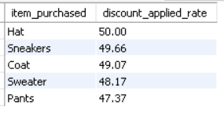
💸 DISCOUNT & PRICING INSIGHTS :
KPI | Value | Analysis | Insight
Top Discounted Products | Hat (50%), Sneakers (49.6%) | Heavy reliance on discounts for sales | Margin risk on popular items
Discount Dependency | Nearly 50% sales via discounts | Customers are price-driven | Need balance between discount & value
Recommendation | Action to Take | Rationale
Reduce Discount Dependency | Gradually decrease discounts, test bundle pricing | High discount reliance reduces profit margins
Strategic Discount Allocation | Apply discounts on low-performing products like Outerwear | Use discounts to drive demand, not reduce margins on top products

Slide 8
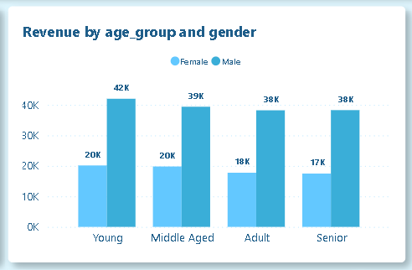
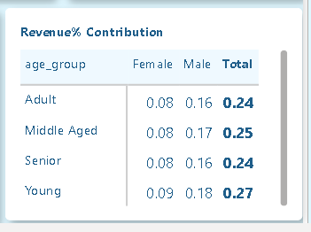
DEMOGRAPHIC REVENUE INSIGHTS :
Segment | Revenue % | Analysis | Insight
Young (Male) | 18% | Highest contributing segment | Primary target audience
Middle-aged (Male) | 16.9% | Strong purchasing power | Stable revenue segment
Adult (Male) | 16.4% | Consistent contribution | Broad engagement
Female Segments | ~7–8% each | Lower contribution vs male | Untapped growth opportunity
Recommendation | Action to Take | Rationale
Target Female Customers | Launch gender-specific campaigns and offers | Female segment underperforming → growth opportunity
Scale High-Performing Male Segments | Increase marketing for Young & Middle-aged males | These segments generate highest revenue

Slide 9
SOME MORE RECOMMENDATIONS
Recommendation | Action to Take | Rationale
Leverage Purchase Frequency Cycles | Run time-based campaigns (e.g., 15-day / 90-day reminders and offers) | Customers follow predictable purchase cycles, enabling higher conversion with timely engagement
Optimize Shipping Strategy | Introduce free shipping thresholds and bundle shipping benefits with purchases | Customers are price-sensitive and prefer free shipping, which can increase order value
Enhance Subscription Benefits | Offer free/discounted shipping and exclusive perks for subscribers | Improves subscription adoption and strengthens customer retention

